Slide 1
Components of Computers
Austin Reid

Slide 2
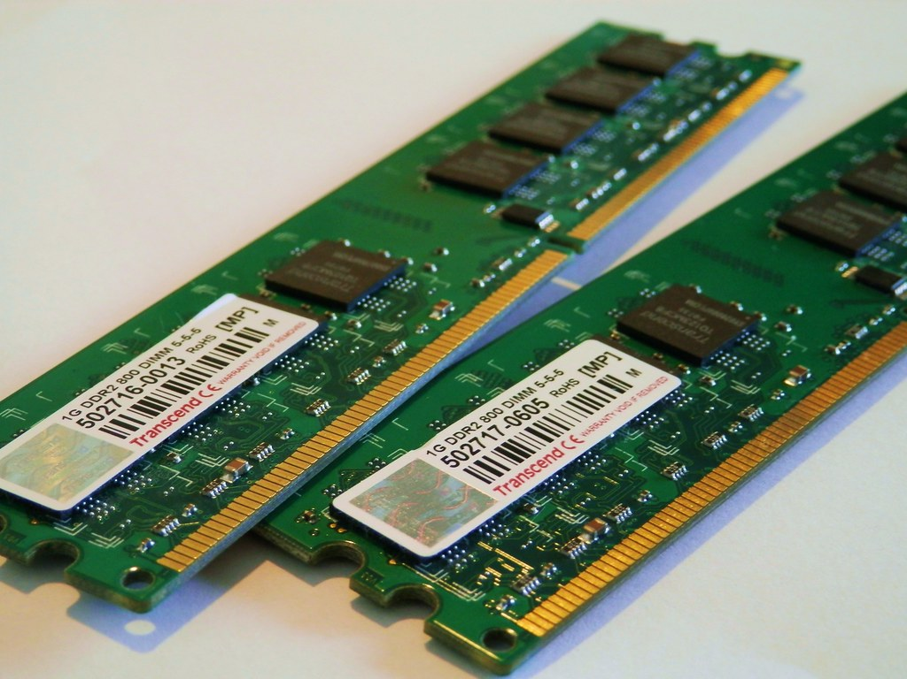
Memory
Memory is used for storing involatile/volatile data depending on the hardware used.
DRAM is volatile memory while NAND Flash is non-volatile
Memory itself is a component in which it allows data to be stored to be used a later time for when your operating device requires it.
Source: https://www.flickr.com/photos/dennissylvesterhurd/7633424314/

Slide 3
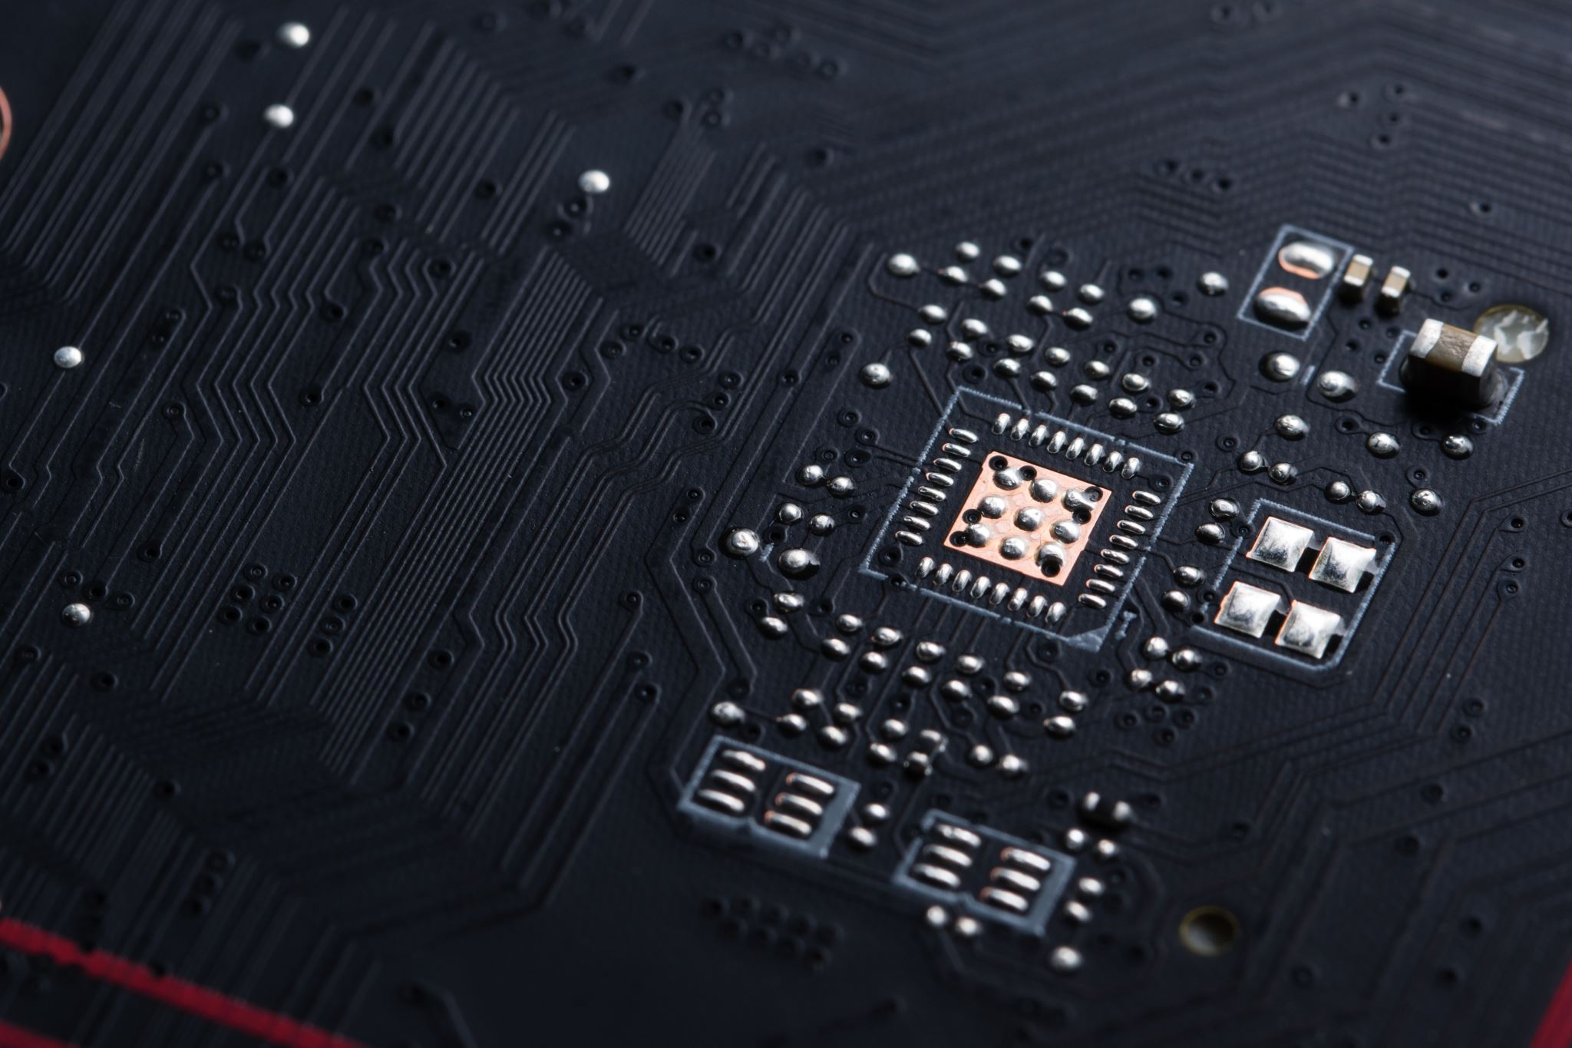
Motherboard
Is an infrastructure (body) for all components for your operating device.
The motherboard sends electrical signals to each component to be interpreted by that component.
Interesting fact: If the electrical signals are delayed or slow, it can cause instability in your device that may cause problems.

Slide 4
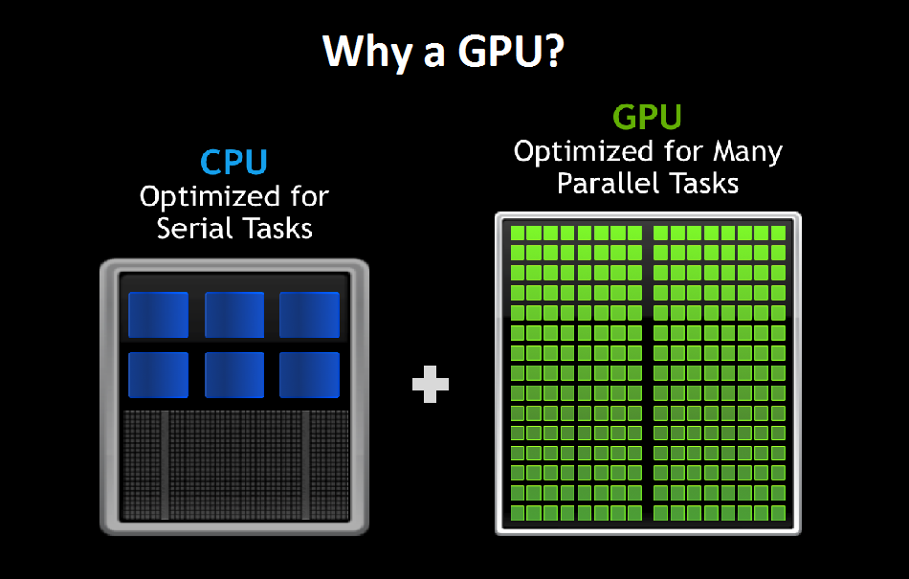
CPU vs GPU
CPUs’ are exceptional at processing multiple processes at one time whereas GPUs are exceptional at rendering visuals, which involves doing extreme amounts of calculations.
CPUs’ compute processing
GPUs’ render graphics
GPUs and CPUs used to get bottlenecked between brands, though due to the technological advancements, bottlenecking is of little worry.
This Photo by Unknown Author is licensed under CC BY-SA-NC

Slide 5
Computer History Section

Slide 6
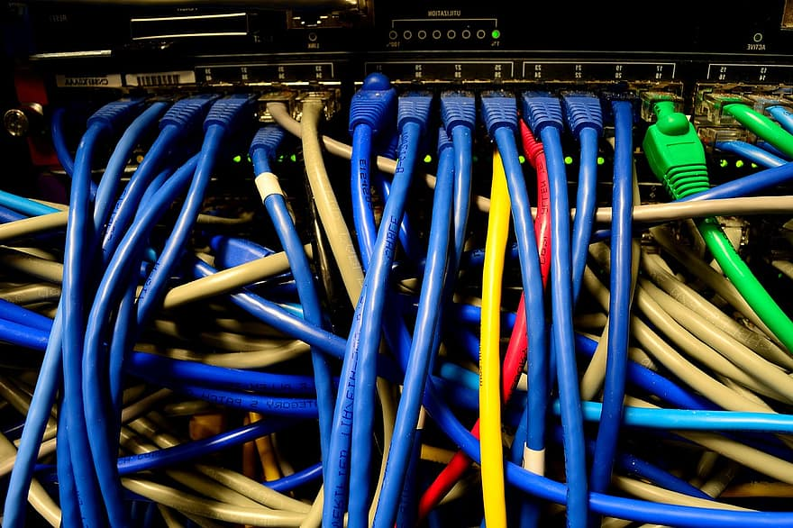
Ethernet Cable
Created in 1973.
The event was important because Ethernet cables became the backbone of networking systems.
Xerox PARC created the Ethernet cable which allowed speeds of 2.94 mb/s.
In the modern age, speeds can be up to 100Gb/s.

Slide 7
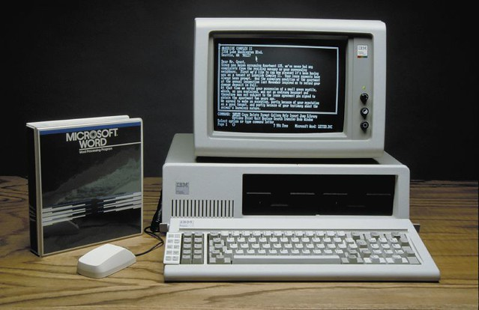
IBM PC
Released August 12, 1981.
The event was important because it popularized the term PC as Personal Computer.
Don Estridge created the first personal computer.
IBM has been around for 100+ years!
This Photo by Unknown Author is licensed under CC BY-SA-NC

Slide 8
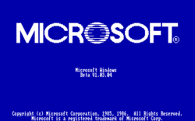
Windows 1.0
Windows first released in 1985.
The first front-end of ms-dos.
Microsoft released an OS that would revolutionize and become a staple product to consumers.
People say that Microsoft copied Apple, though they copied more from Xerox.
This Photo by Unknown Author is licensed under CC BY-SA

Slide 9
Catastrophic Events

Slide 10
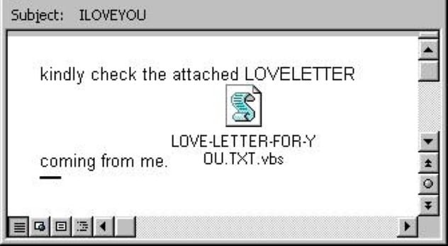
ILOVEYOU
Raymond Ralph Carisma (Lto3) created the ILOVEYOU computer worm.
The outbreak caused US$5.5-9B in damages worldwide.
The worm could’ve been prevented if proper measures were taken in place to protect computers.
There were no laws regarding malware in the Philippines, all charges were dropped by state prosecutors.
Picture sourced from: https://listverse.com/2019/07/30/top-10-most-catastrophic-computer-failures-in-history

Slide 11

Meltdown
A vulnerability present in all Intel CPUS from 1995 – 2018.
The exploit was able to bypass privilege checks gaining access to financial and personal information while avoiding Anti-virus software.
Avoiding the use of memory mapping and using a software-based solution would prevent this.
There is no way to detect this attack if it is carried out.
Sourced: https://listverse.com/2019/07/30/top-10-most-catastrophic-computer-failures-in-history/

Slide 12
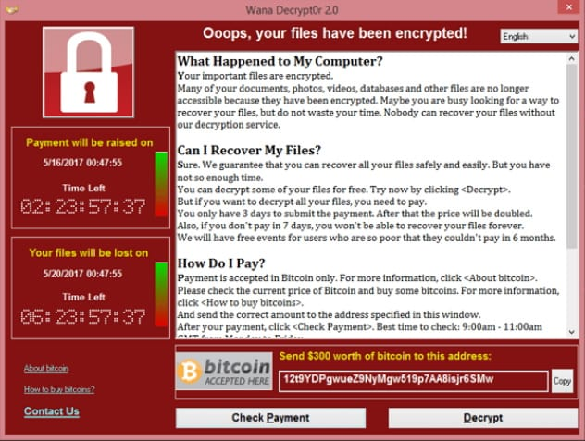
WannaCry
Form of ransomware that launched in May 2017.
Ransom demanded $300-$600 per computer, worldwide it cost $4 Billion.
It could’ve been prevented by using newer operating systems with updated security.
The West placed the blame on North Korea.
Sourced: https://listverse.com/2019/07/30/top-10-most-catastrophic-computer-failures-in-history/

